Slide 1
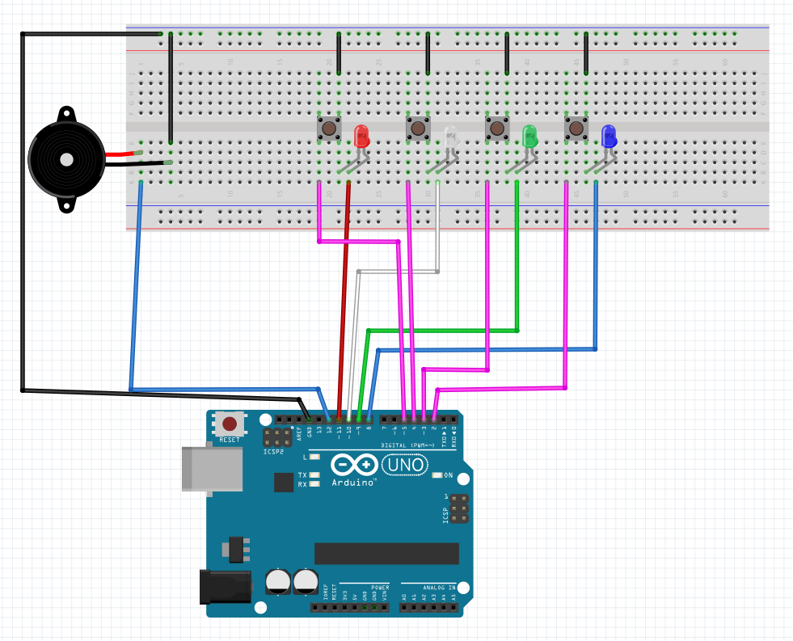
Arduino Memory game
By Robotics guruji

Slide 2
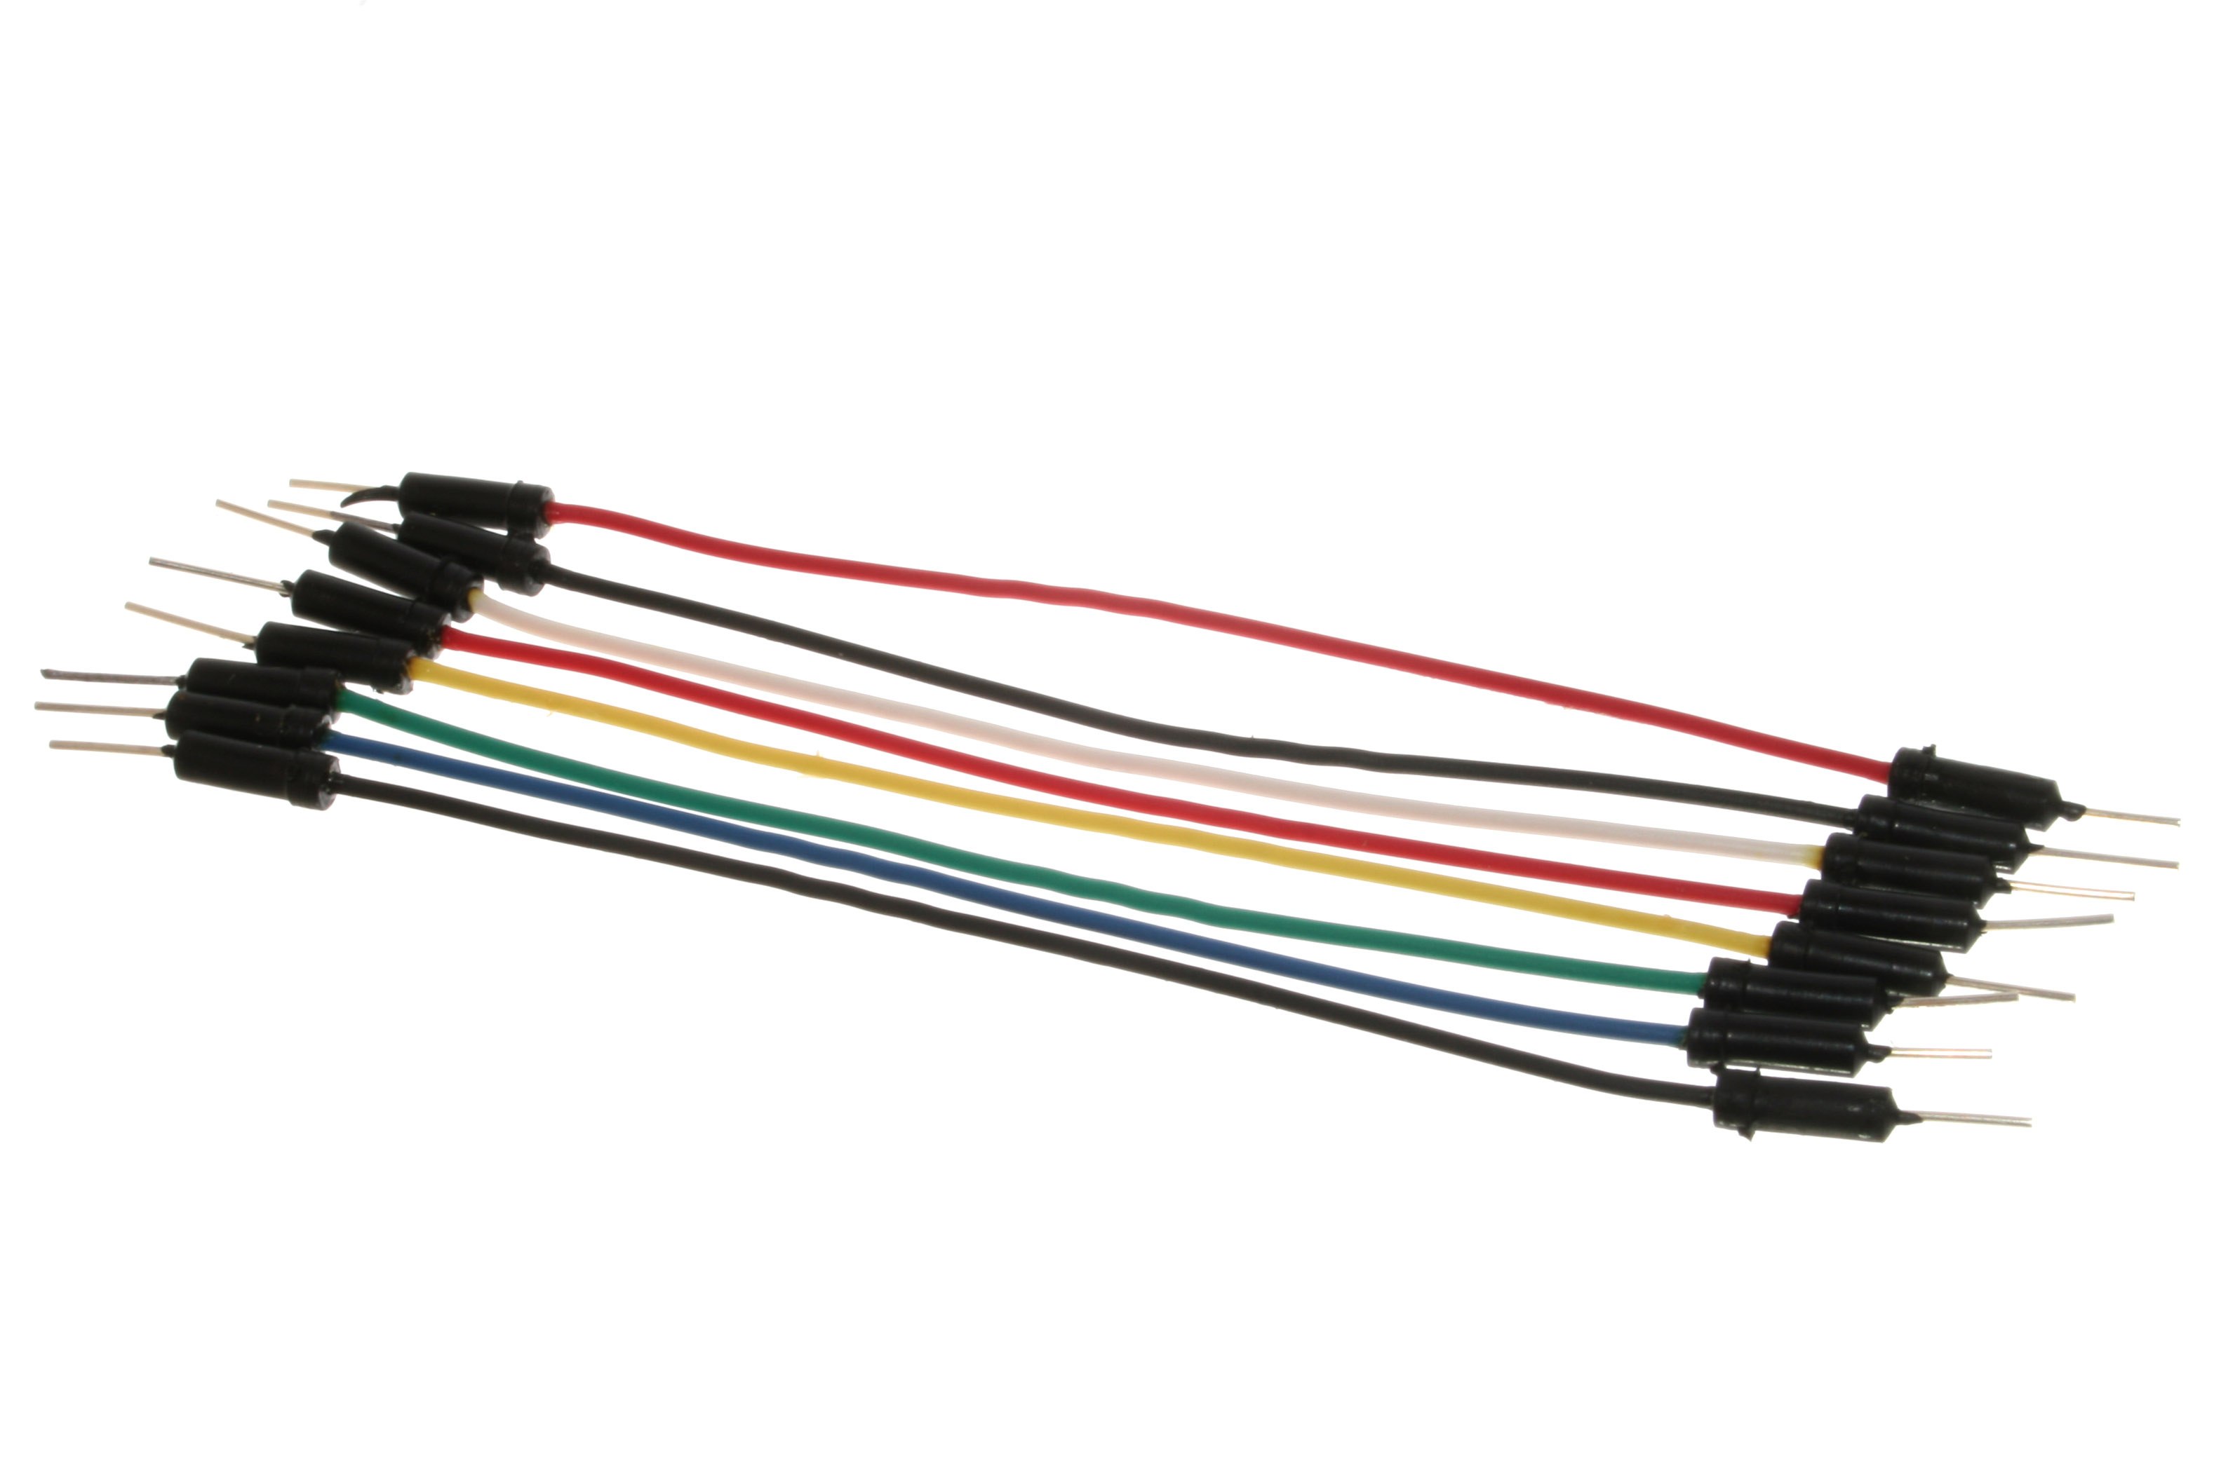
Parts required
Arduino UNO board
Breadboard
Jumper wires
Piezo buzzer
4 pushbuttons
4 LEDs

Slide 3
LIBRARIES REQUIRED
Tone.h
Author: Brett Hagman
Url: https://github.com/bhagman/Tone

Slide 4
HOW IT WORKS
This memory game plays a short introductory tune and flashes an LED. When you press the correct corresponding button, the lights flash again in a longer sequence. Each time you repeat the sequence back correctly, the game adds an extra step to make the sequence more challenging for you. When you make an error, the game resets itself.

Slide 5
SOURCE CODE
https://github.com/RoBoTiCsGURUJI/Arduino-memory-game/blob/master/Memory_game.ino

Slide 6

Thanks for watching
Please like and subscribe my channel if you liked it. My Channel URL is RoBoTicS GURUJI.
My personal high score in this memory game is 15, lets see how much you score. Thanks once again.

